Slide 1
Java Programming
1

Slide 2
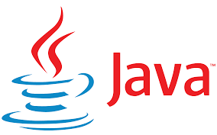
WHAT IS JAVA?
Java is one of the most popular and widely used programming language and platform. A platform is an environment that helps to develop and run programs written in any programming language.
Java is fast, reliable and secure. From desktop to web applications, scientific supercomputers to gaming consoles, cell phones to the Internet, Java is used in every nook and corner.
Java Environment: The programming environment of Java consists of three components mainly:
JDK
JRE
JVM

Slide 3
It is a general-purpose programming language intended to let programmers write once, run anywhere (WORA), meaning that compiled Java code can run on all platforms that support Java without the need for recompilation.
JAVA was originally developed by sun microsystems by James Gosling and it has been now acquired by Oracle.
Java was originally designed for interactive television, but it was too advanced for the digital cable television industry at the time.
Initially, the JAVA was called Oak which was named after an Oaktree which stood outside Gosling’s office.
Later, that project went by the name green and finally named as JAVA, from JAVA coffee, which is a type of coffee from Indonesia.
As of September 2021, Java 8, 11 and 17 are considered as Long-Term Support(LTS) versions.

Slide 4
JDK || JRE || JVM
Java Development Kit (JDK) is a software development environment used for developing Java applications and applets. It includes the Java Runtime Environment (JRE), an interpreter/loader (Java), a compiler (javac), an archiver (jar), a documentation generator (Javadoc), and other tools needed in Java development.
JAVA Runtime Environment(JRE):Now we need an environment to make a run of our program. Henceforth, JRE stands for “Java Runtime Environment” and may also be written as “Java RTE.” The Java Runtime Environment provides the minimum requirements for executing a Java application; it consists of the Java Virtual Machine (JVM), core classes, and supporting files

Slide 5
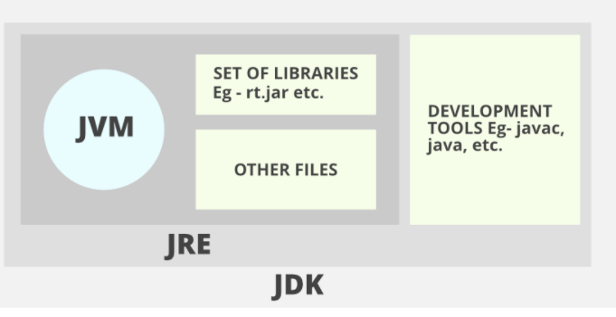
JDK || JRE || JVM
JVM (Java Virtual Machine) is a very important part of both JDK and JRE because it is contained or inbuilt in both. Whatever Java program you run using JRE or JDK goes into JVM and JVM is responsible for executing the java program line by line, hence it is also known as an interpreter.

Slide 6
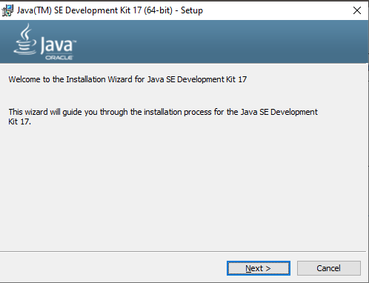

Slide 7
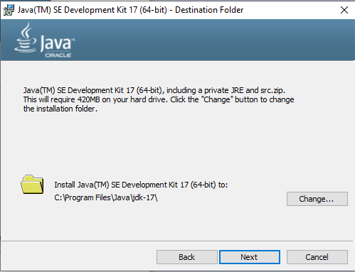

Slide 8
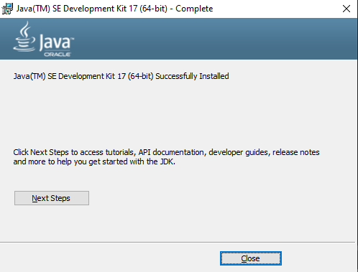

Slide 9
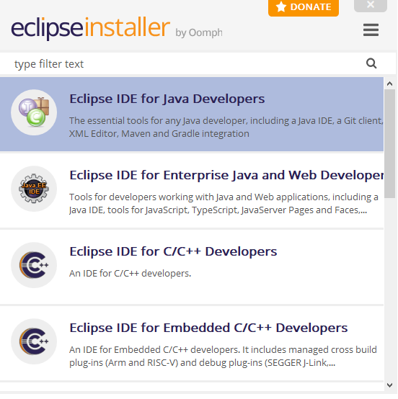

Slide 10
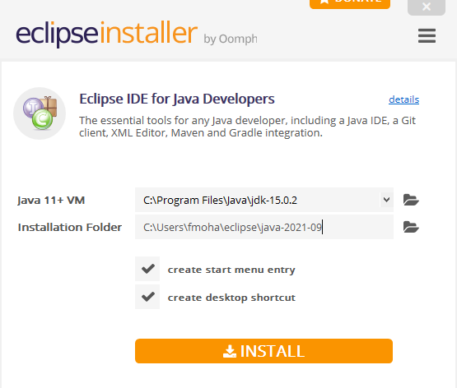

Slide 11
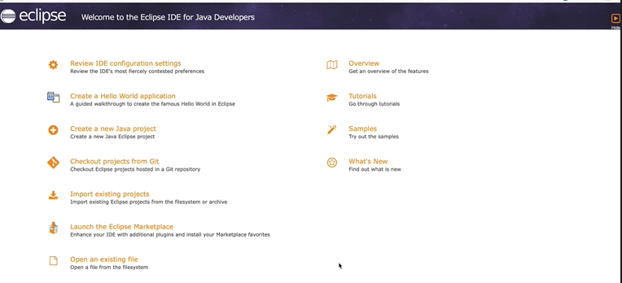

Slide 12
Writing your first program
The JVM (Java Virtual Machine) interprets the byte code into the machine code. It is responsible for all the things like garbage collection, array bounds checking, etc… Java Virtual Machine provides a platform-independent way of executing code.
The process of Java programming can be simplified in three steps:
Create the program by typing it into a text editor and saving it to a file – HelloWorld.java.
Compile it by typing “javac HelloWorld.java” in the terminal window.
Execute (or run) it by typing “java HelloWorld” in the terminal window.

Slide 13
Writing your first program
class HelloWorld
{
public static void main(String args[])
{
System.out.println("Hello Java");
}
}
The JVM (Java Virtual Machine) interprets the byte code into the machine code. It is responsible for all the things like garbage collection, array bounds checking, etc… Java Virtual Machine provides a platform-independent way of executing code.

Slide 14
Data Types in JAVA
Data types specify the different sizes and values that can be stored in the variable. There are two types of data types in Java:
Primitive data types: The primitive data types include boolean, char, byte, short, int, long, float and double.
Non-primitive data types: The non-primitive data types include Classes, Interfaces, and Arrays.
The JVM (Java Virtual Machine) interprets the byte code into the machine code. It is responsible for all the things like garbage collection, array bounds checking, etc… Java Virtual Machine provides a platform-independent way of executing code.

Slide 15
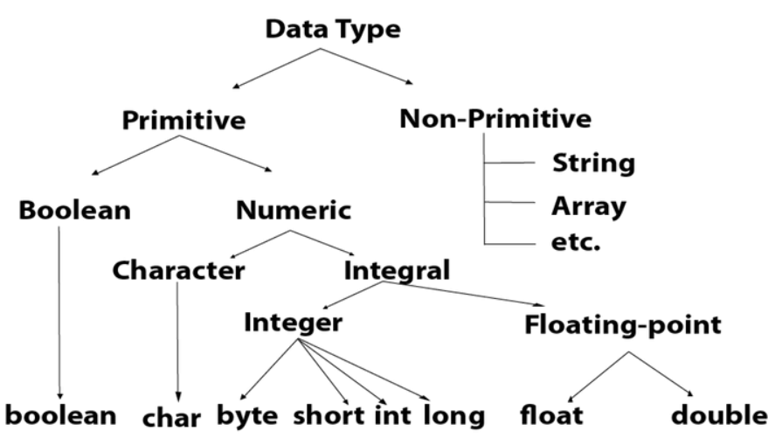
Data Types in JAVA

Slide 16
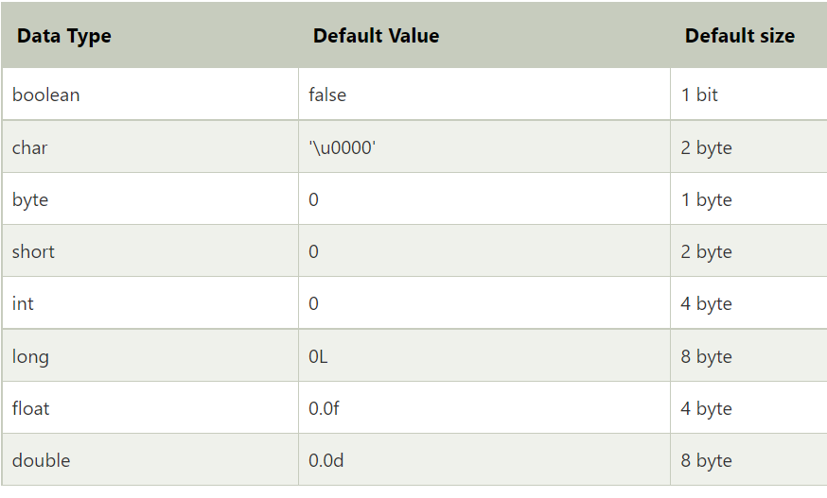

Slide 17
Operators in JAVA
Operator in Java is a symbol that is used to perform operations. For example: +, -, *, / etc.
There are many types of operators in Java which are given below:
Unary Operator,
Arithmetic Operator,
Shift Operator,
Relational Operator,
Bitwise Operator,
Logical Operator,
Ternary Operator and
Assignment Operator.
Assignment Operator.

